Slide 1
One out of many proofs
@double

Slide 2
Preliminaries
y = A(x; r) when the algorithm A on input x and randomness r, outputs y
y ← A(x) for the process of picking randomness r at random and setting y = A(x; r)
y ← S for sampling y uniformly at random from a set S
Homomorphic commitment

Slide 3
Σ-protocols
A Σ-protocol is a special type of 3-move interactive proof system that allows a prover to convince a verifier that a statement is true

Slide 4
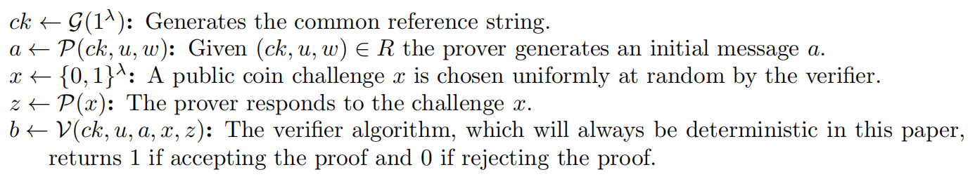
Σ-protocols
The following run of a Σ-protocol describes the interaction of the algorithms

Slide 5

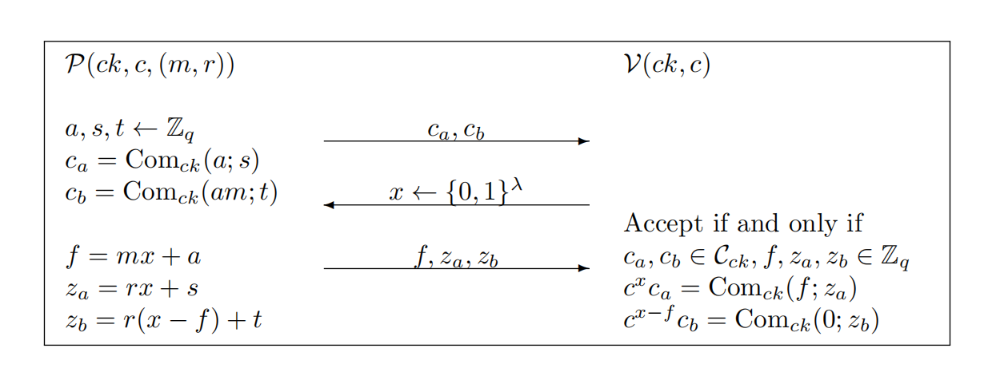
Σ-protocol for commitment to 0 or 1
give a Σ-protocol for the relation :

Slide 6
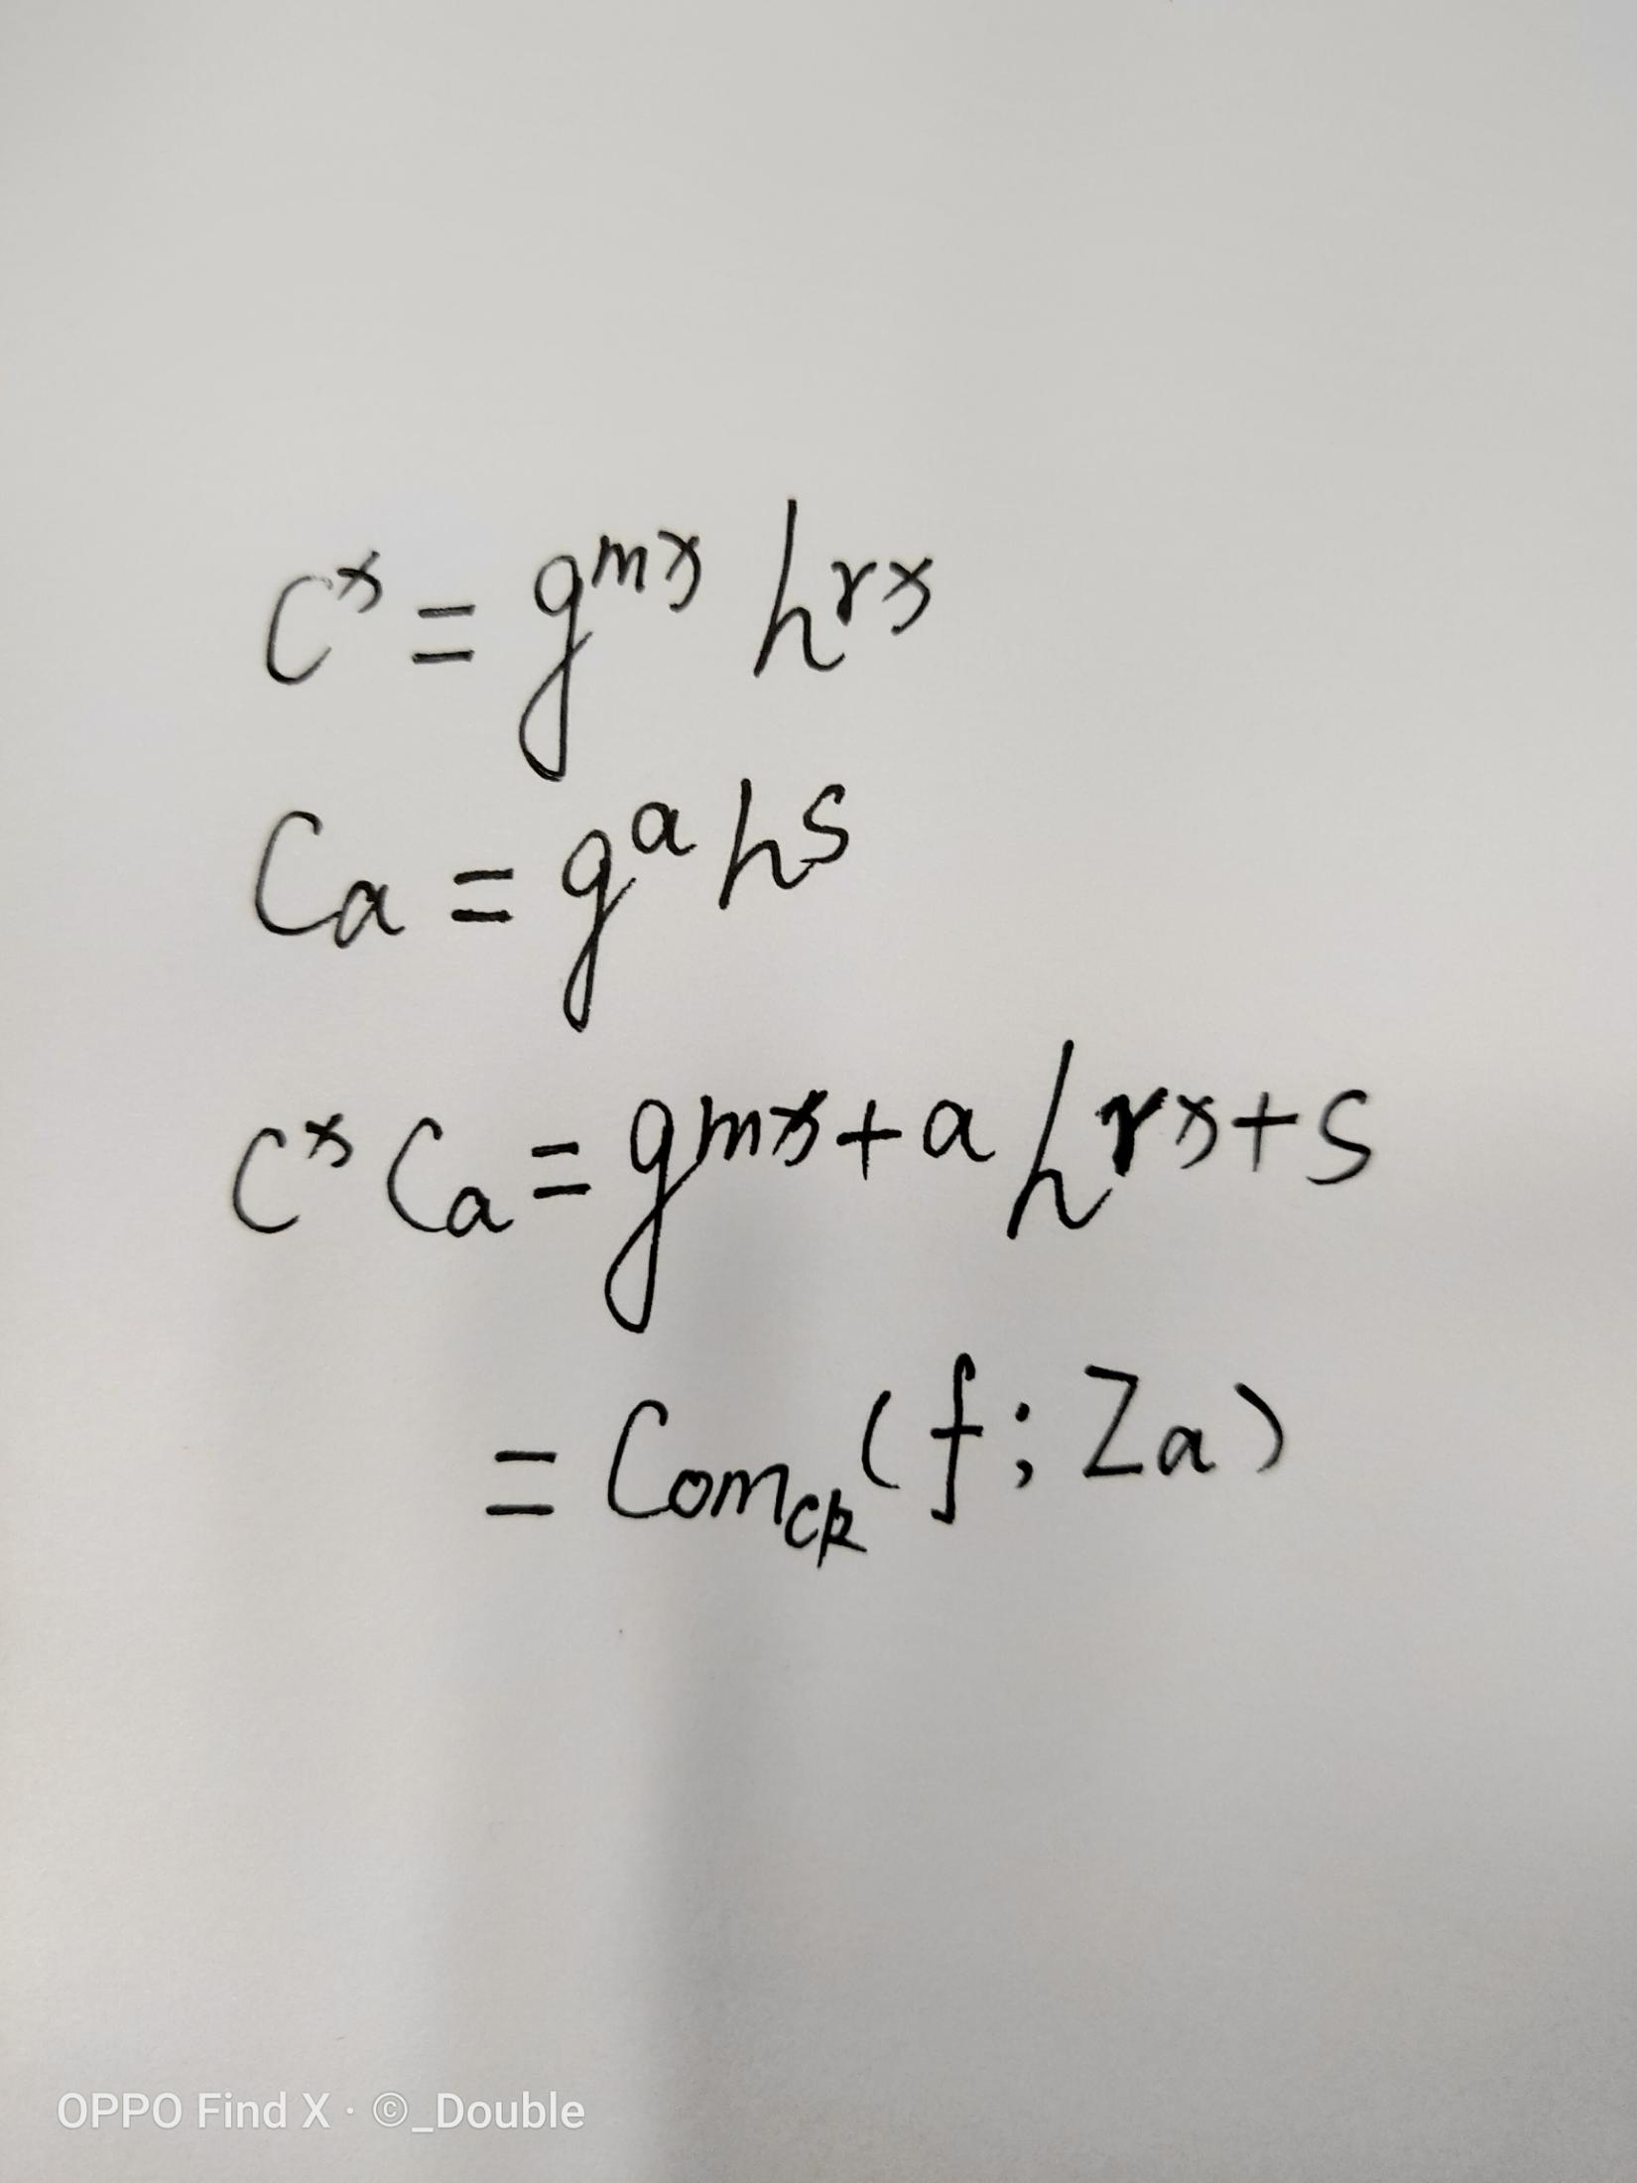
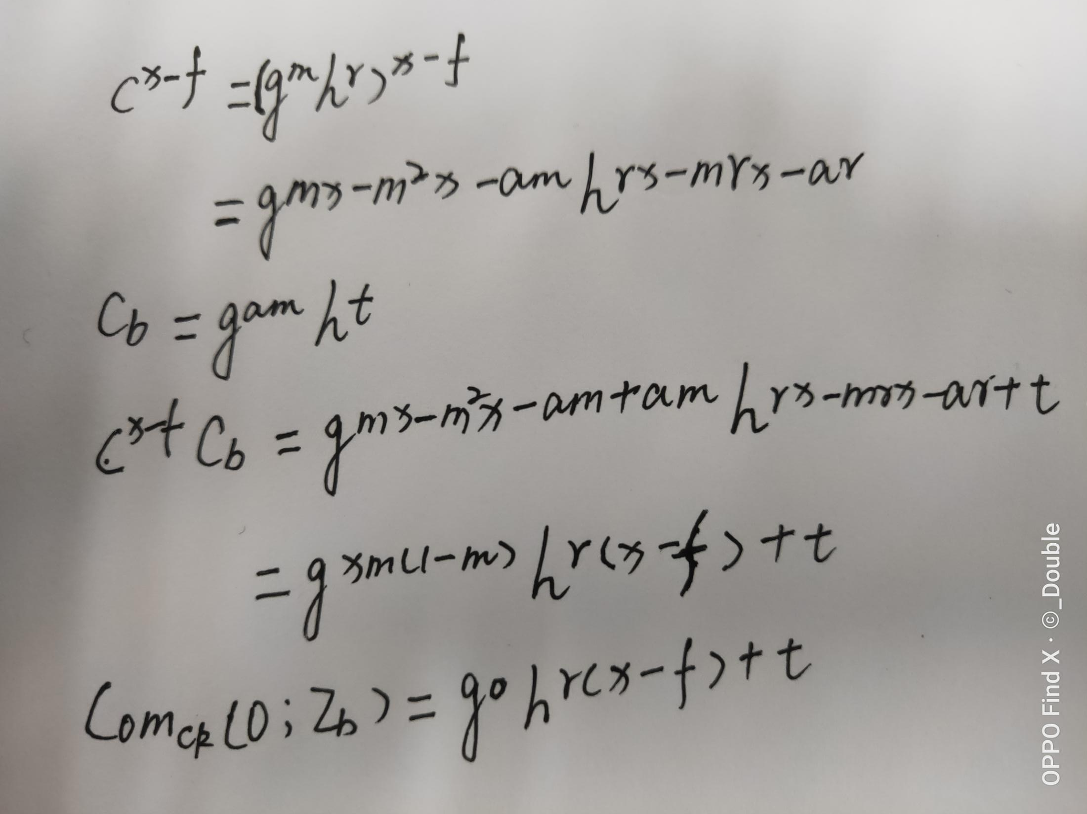
Σ-protocol for commitment to 0 or 1

Slide 7
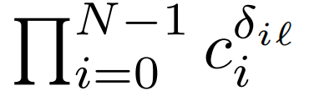


Σ-protocol for one out of N commitments containing 0
give a Σ-protocol for the relation :
Saying that one of the commitments contains 0 is equivalent to saying there exists an index “l” like below is commitment to 0

Slide 8



Σ-protocol for one out of N commitments containing 0

Slide 9

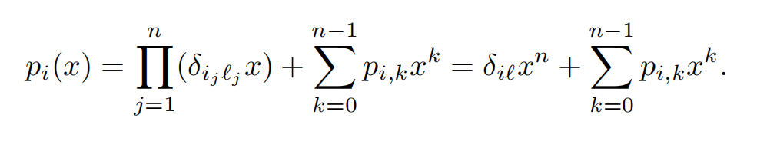
Σ-protocol for one out of N commitments containing 0
In order to prove that in one polynomial
the prover reveals

Slide 10
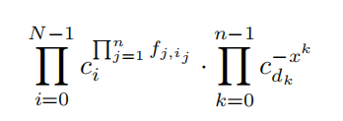

Σ-protocol for one out of N commitments containing 0

Slide 11
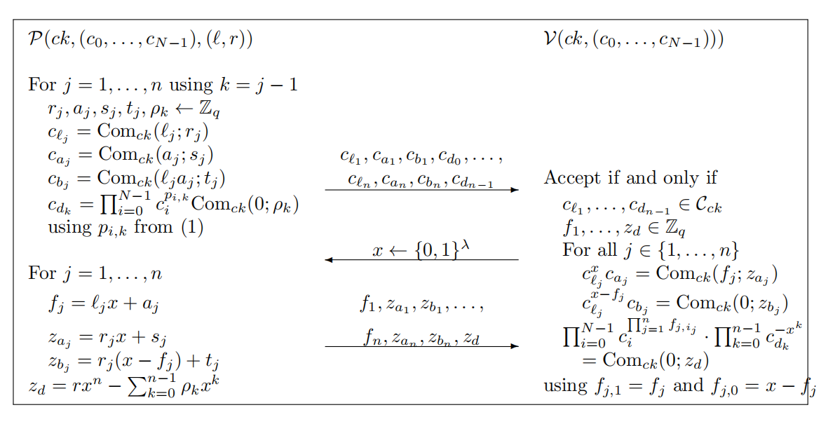
Σ-protocol for one out of N commitments containing 0

